Slide 1
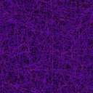
Manfaat Power Point Presentation
Created By Zaki

